Slide 1
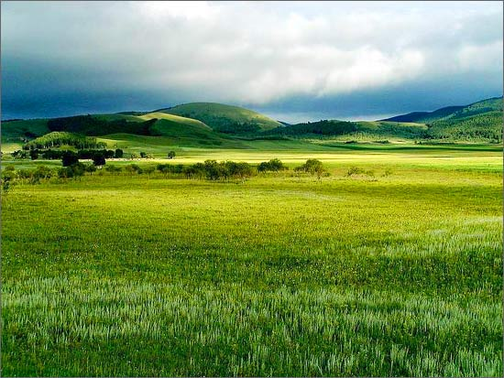
Name: Engineer Harsh A. Branch: Mechanical Engineering Enrollment No: 130090119031 Roll No: 185 College: C.K.P.C.E.T. Division: B Topic: Grass Land Eco System

Slide 2
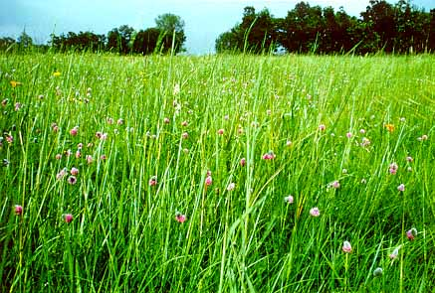
GRASS LAND ECO SYSTEM
Grass Land are areas covered by grass instead of big trees because of low rainfall compared to forest areas they occupy 19% of earths total surface.
Famous grass lands are,
Praries
plains
Savannas, etc

Slide 3
FUNCTIONS OF GRASS LAND ECOSYSTEM
To increase the fertility of soil and to regulate the productivity of ecosystem.
To provide shelter and food directly and indirect to animals, insects and birds.
To reduce the leaching of minerals due low rainfall.
To have more cultivated grasses and grain crop.

Slide 4
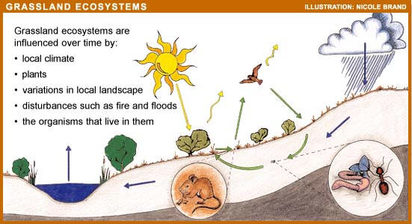
COMPONENTS OF GRASS LAND ECOSYSTEMS
Biotic Components:
Producers:
Green Plants, grass, bushes, shrubs etc.
Consumers:
Primary Consumers:
Grass hopper, rabbit, mice, deer, cow etc.
Secondary Consumers:
Lizards, Snake.
Tertiary Consumers;
Big birds like: Hawk, Eagle etc.
Decomposers:
Bacteria, Micro-organisms

Slide 5
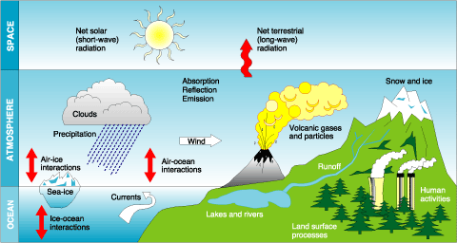
Abiotic Component:
Climatic factors:
Temperature, rain fall, sunlight, wind etc.
Edaphic Factors:
Soil ph, Minerals in soil, Moisture in Gases.

